Slide 1
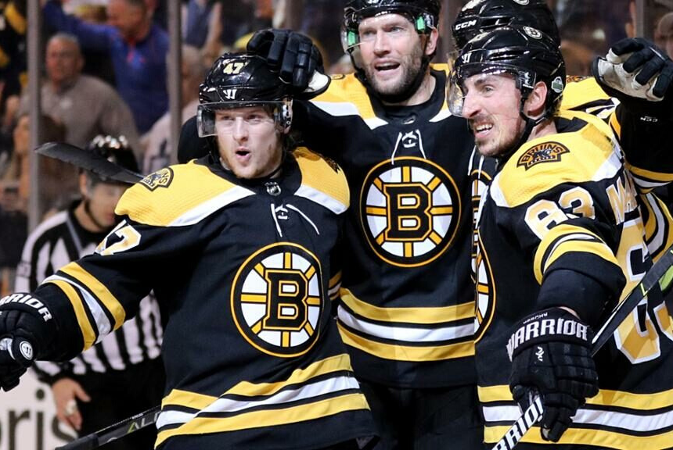


Predicting Team & Player Performance
Jenny, Joshua, Ray,
Anshuman, Peng.

Slide 2
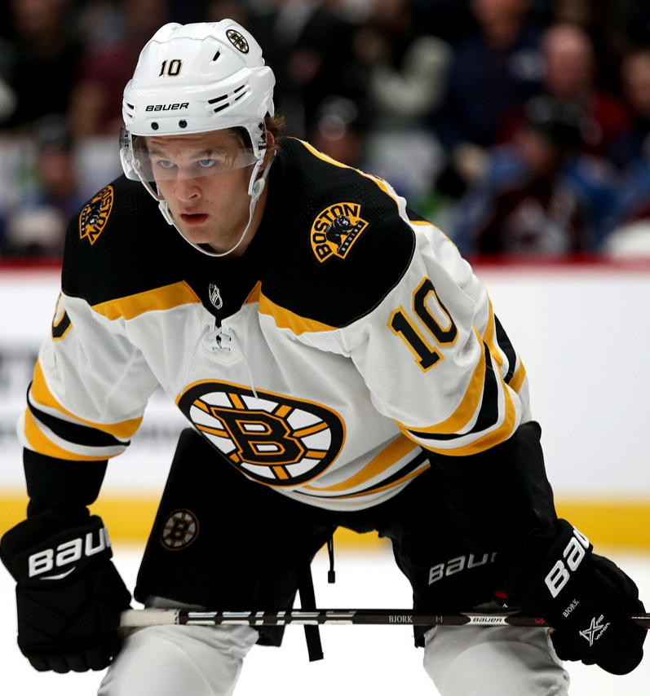
Objective
Question 1
Predicting Pts% for the next quarter for the Boston Bruins
Question 2
Predict Player performance for rest of the season (2019-20) & evaluate their next contract price. The two teams taken into consideration are Boston Bruins & Toronto Maple Leafs
.

Slide 3
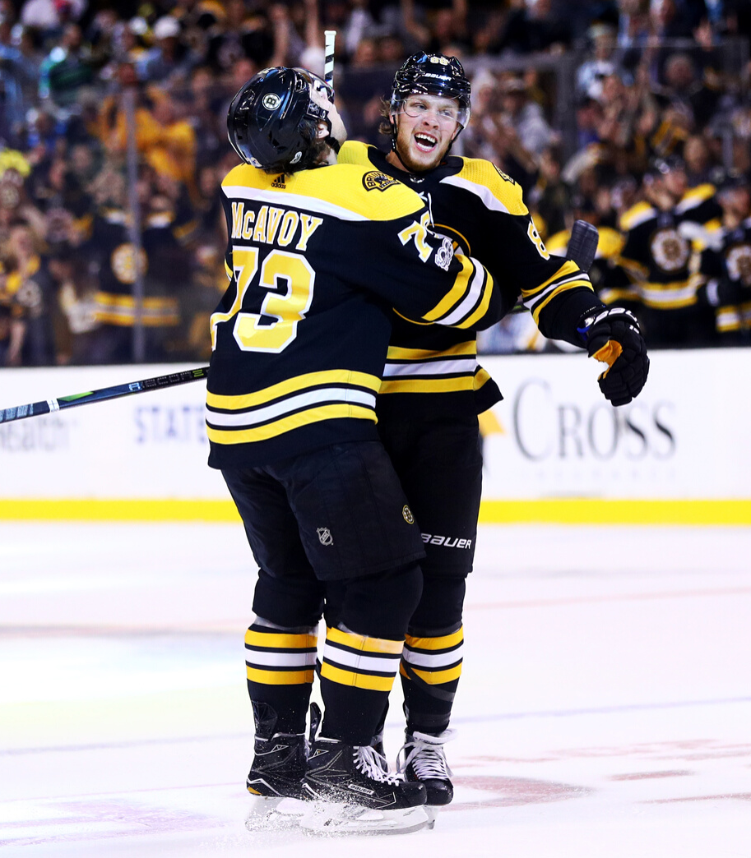

Question 1
Introduction
Team with more points during season is ranked higher
Predicting the number of points a team will accrue in a season is hard
Dataset contains 57 quarters of Percentage Points for Boston Bruins
This project introduces fundamental model of predicting a team’s percentage points over the next quarter season without any regressors
The future of the Boston Bruins is…?!
Notes:
Hockey is a sport of parity.
There are too many variables to consider to answer this question.
We have a small dataset.

Slide 4
Question 1
Data Characteristics
The future of the Boston Bruins is…?!
Source, Outliers, Trends & Patterns
Modeling
STL Decomposition, Naive Model, ETS Model
Conclusions
Key Findings & Limitations
Notes:
Three sections

Slide 5

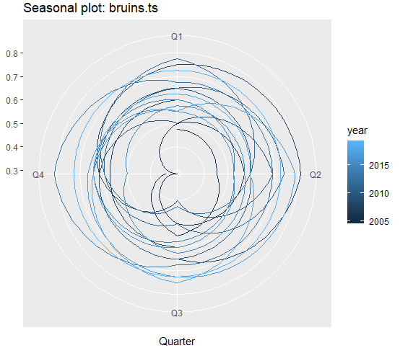

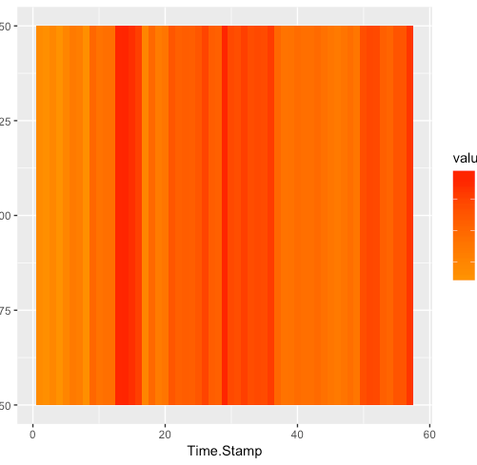
Data Characteristic
Checking Trends & Seasonality
Polar Plot : No Trend Observed. Difficult to conclude if Bruins is playing better or worse over the course of time
Heatmap: 5 segments can be separated on the basis of color. Each color showing different levels of performance (Average, Above average, Extremely well etc)
Notes:
Over the last few years, the Bruins have been considered a Stanley Cup Contender, a legitimate choice for winning the championship.
Before the arrival of current greats like Patrice Bergeron, David Krejci, and Brad Marchand, the Bruins were a void of hockey talent.
Polar plot also hints at team performance from the area within color bands, with a larger area meaning better performance in season.
Heatmap tells the story of the different eras of Bruins Hockey. The dark strips in the middle of graph represent the time when the Bruins won the championship in 2011 and returned to the finals in 2013.

Slide 6
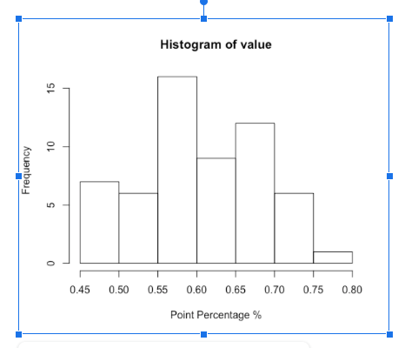
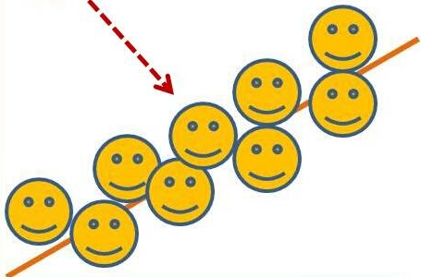
Data Characteristic
Season 2012-13 Anomaly: Dispute between league & players association.
38 games were cancelled
Entropy: 1.19 without noticing error.
Averaging 2 quarters entropy dropped to 0.96 (20% decrease)
Outliers:Most values in Histogram range from 0.45 to 0.8
TS Outliers confirms !
Notes:
2012-2013 labor dispute
Entropy went down 20% by taking an average of the year before and the year after and imputing the two missing quarters
No outliers. Despite the league’s reputation for parity, somehow the Bruins have been outperforming the league on average.

Slide 7
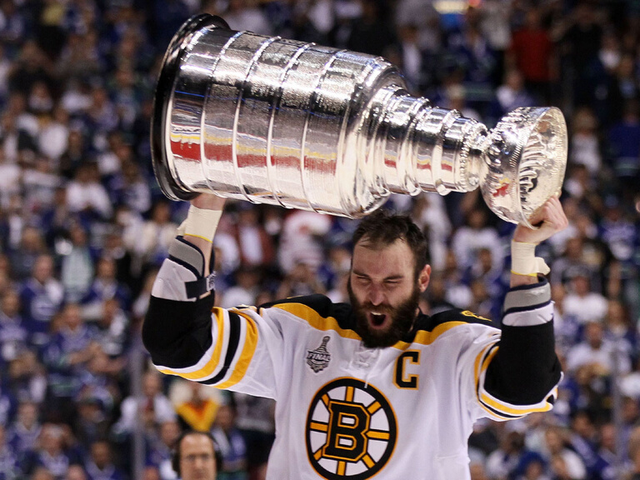
Modeling
Tests of Non-linearity
P-Value of most tests >0.05, "indicating a non-linear model is not necessary"
Transformation
Box- Cox lambda , parameter generated is -0.0731
Testing Set
2 Observations taken for Testing Set
Goal is to forecast Points % for next quarter
Box- Cox lambda , parameter generated is -0.0731

Slide 8
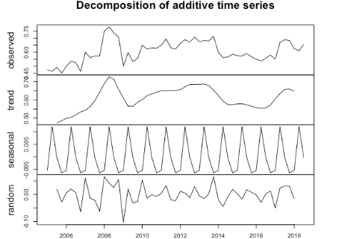
Naive Model
Created to Benchmark for comparison purposes
STL Decomposition
No clear upward or downward trend
Yearly Seasonality observed
Accuracy measures are saved & compared later

Slide 9
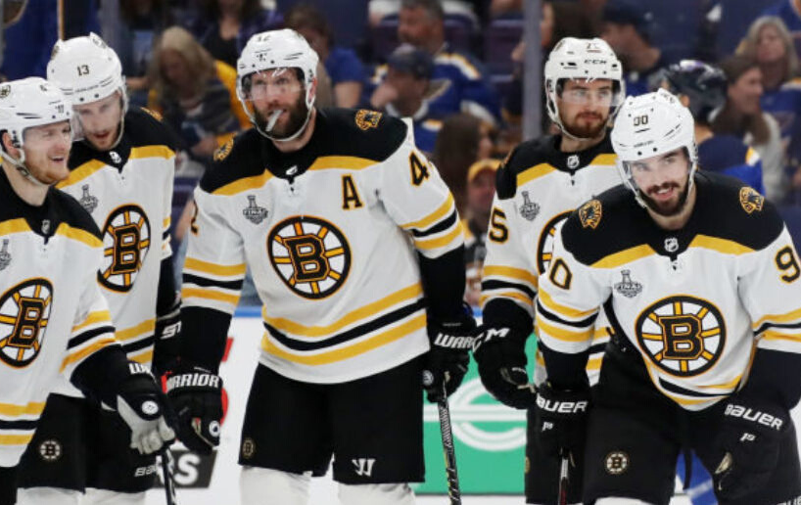
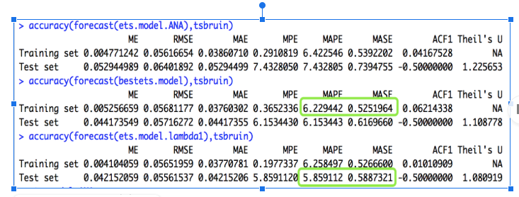
Accuracy Comparison
ETS (A,N,A) : Largest MAPE, MASE & AIC
ETS Models
Best ETS with lambda = 1 is the best candidate for prediction
Best ETS with lambda -0.073 : Best in sample MAPE & MASE
Best ETS with lambda 1 : Best Testing MAPE & MASE

Slide 10


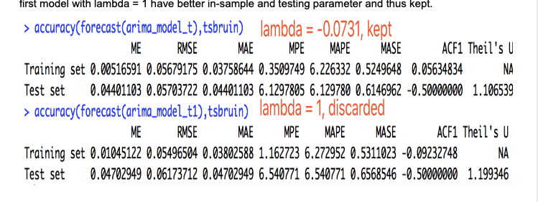
ARIMA Models
ARIMA (1,1,1)
Created using brute force method and lambda =1
1 lag difference is taken to make the model stationary, then one value and one error from previous quarter are referred to generate the next forecast
ARIMA (0,1,1)
Second model with lambda =-0.0731 generated a (0,1,1) model
Comparing MASE and MAPE value, the first model with lambda = 1 have better in-sample and testing parameter

Slide 11
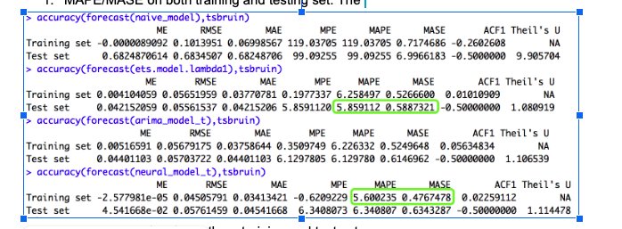

Model Comparison
4 Models are compared : Naive, ETS, ARIMA & Neural Network

Slide 12
Future Roadmap
Expanding Analysis
1
Forecasting Games
What are your next steps and goals?
Adding Observations
2
More Information
Causal Regressors
3
Enhance ARIMA Models
Notes:
Take forecasts for each team based on their historical performance game by game, adjust for difficulty of opponent, and simulate a season.
Helps data hungry models like Neural Network, but overall can allow a larger training set which is better for accuracy as long as the historic data is relevant.
Many interesting variables could be causal regressors, such as strength of opponent per Season, or aggregate Salary of roster players, etc.

Slide 13

Analysis Critique
Did not account for roster changes
Did not include interesting parameters
Could dig deeper into interesting finds
Notes:
Roster changes happen every year, and the loss of a good player or trading away a player who was well liked can cause slumps in performance.
Interesting parameters like hot streaks, injuries, home ice advantage, etc.
Look into the heatmap, what caused long stretches of average performance, great performance.

Slide 14







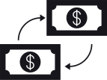







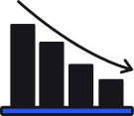








Free Resources
Use these free and recolourable icons and illustrations in your Canva design.

